Slide 1



facebook EDA
PROJECT
Analysis
Attributes
Objective
About
Report with findings and recommendations
Submitted By VINOD RAWAT

Slide 2
Facebook user data
To identify facebook usage patterns
Analysis
Attributes
Objective
About
Understand Target Market & build Strategies

Slide 3



Correct Recommendations based on Insights
Analysis
Attributes
Objective
About
User
Demographics
Platform
Identify facebook user usage pattern
across gender
Identify facebook user demographics through their different age groups
Identify different platform used for facebook and most preferred one.

Slide 4





99 K
Age
Gender
Tenure
Friend count
Mobile & Web
User
Demographic
Activity
Platform
Tenure
Likes
Friendship Initiated
User DOB
1
2
3
4
5
Based on
Based on
Based on
Based on
Based on
Analysis
Attributes
About
Gender,
Friends count Friend request
Age groups,
Friends, Friends request across gender
Friends request & Likes across gender and age groups
Mobile & Web usage
Across gender and age groups
Days/Years spend by users and different age groups
Facebook users belong to every age from 13 to 113.
No major correlation among dataset variables except one.
Friend count has strong correlation with friendship initiated.

Slide 5
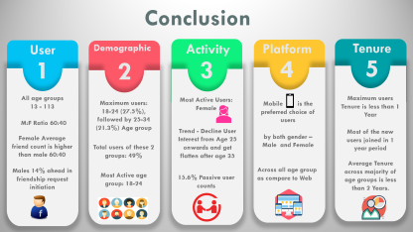
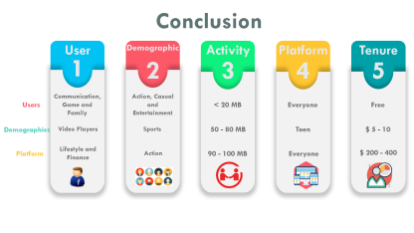
Demographic
User
Activity
Analysis
Attributes
About
Platform
Tenure

Slide 6


Slide 7
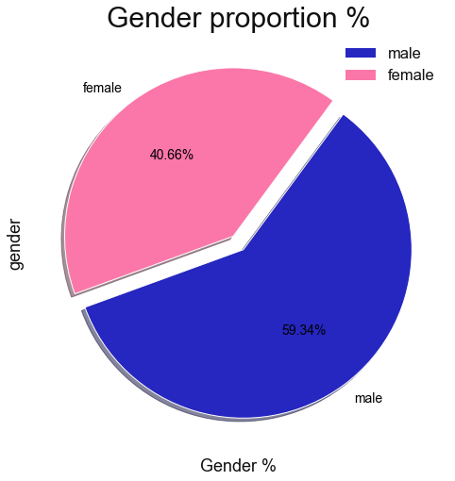
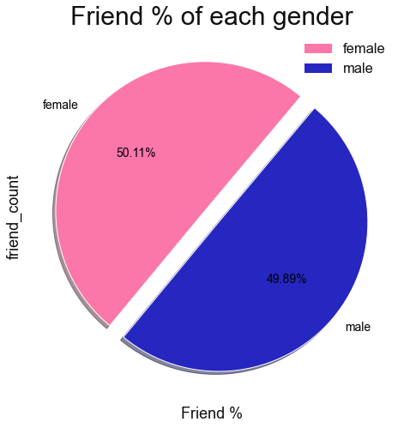
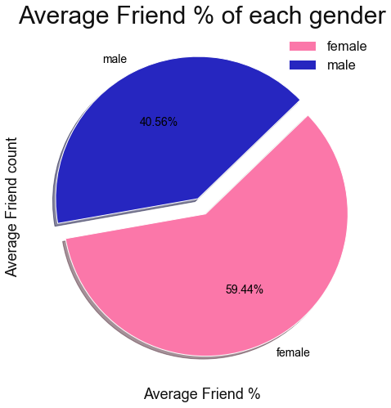
Next

Slide 8
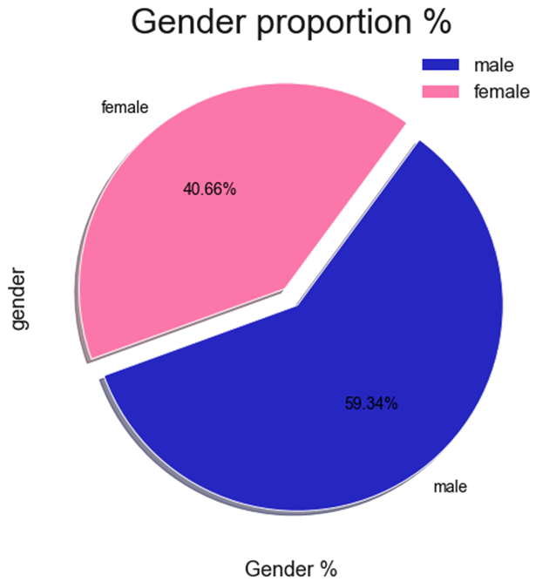

Slide 9
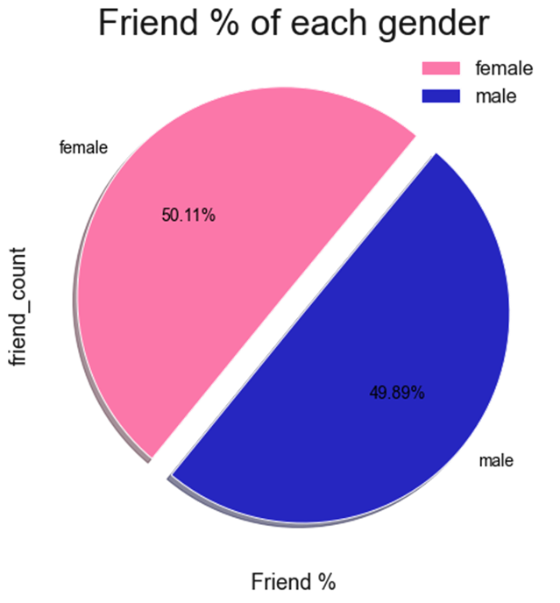

Slide 10
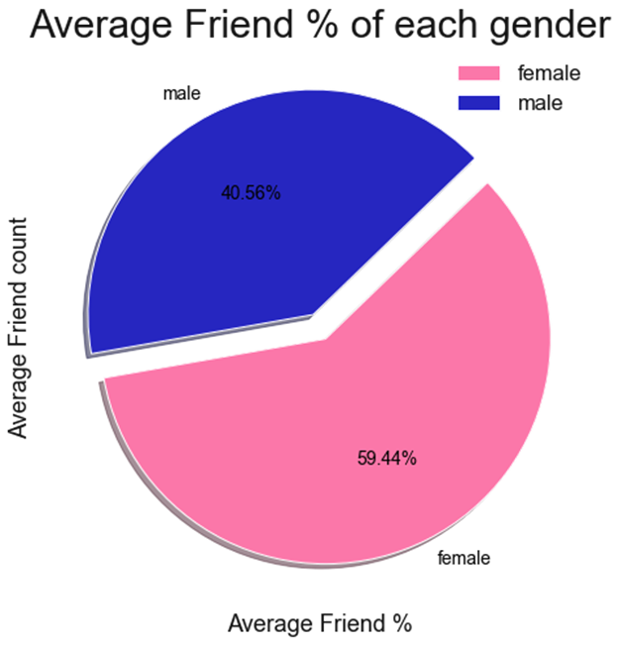

Slide 11
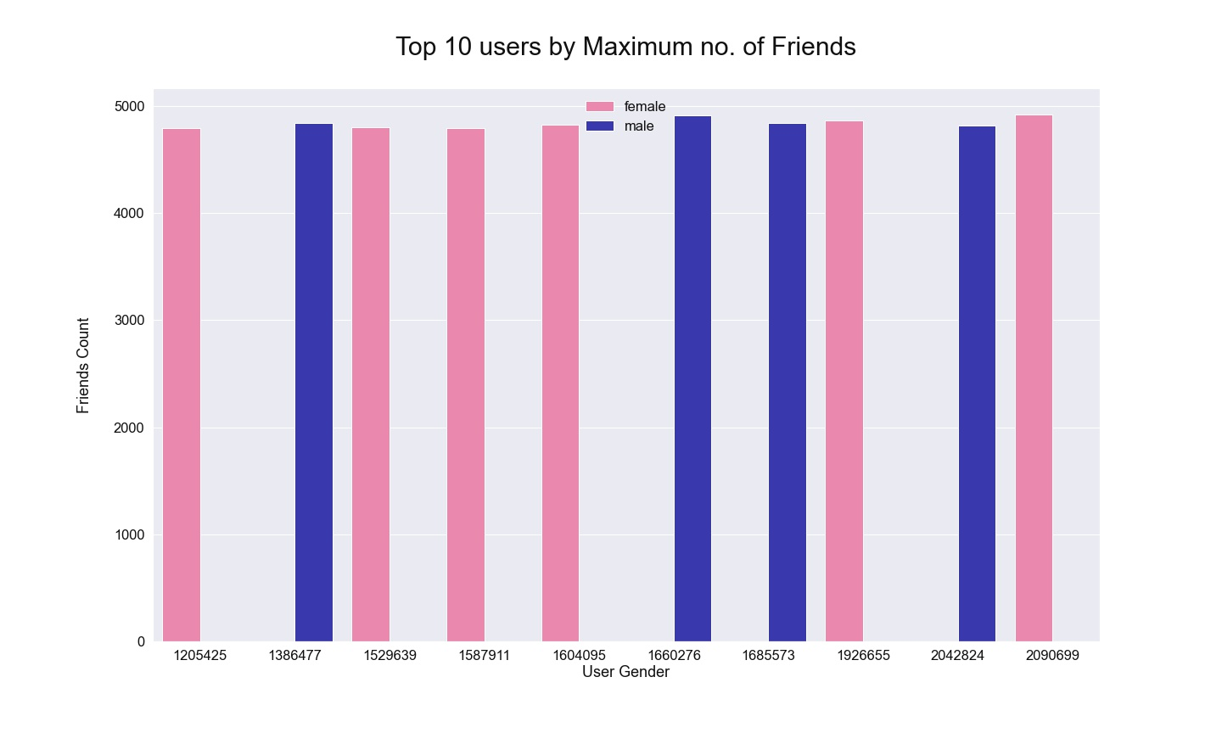
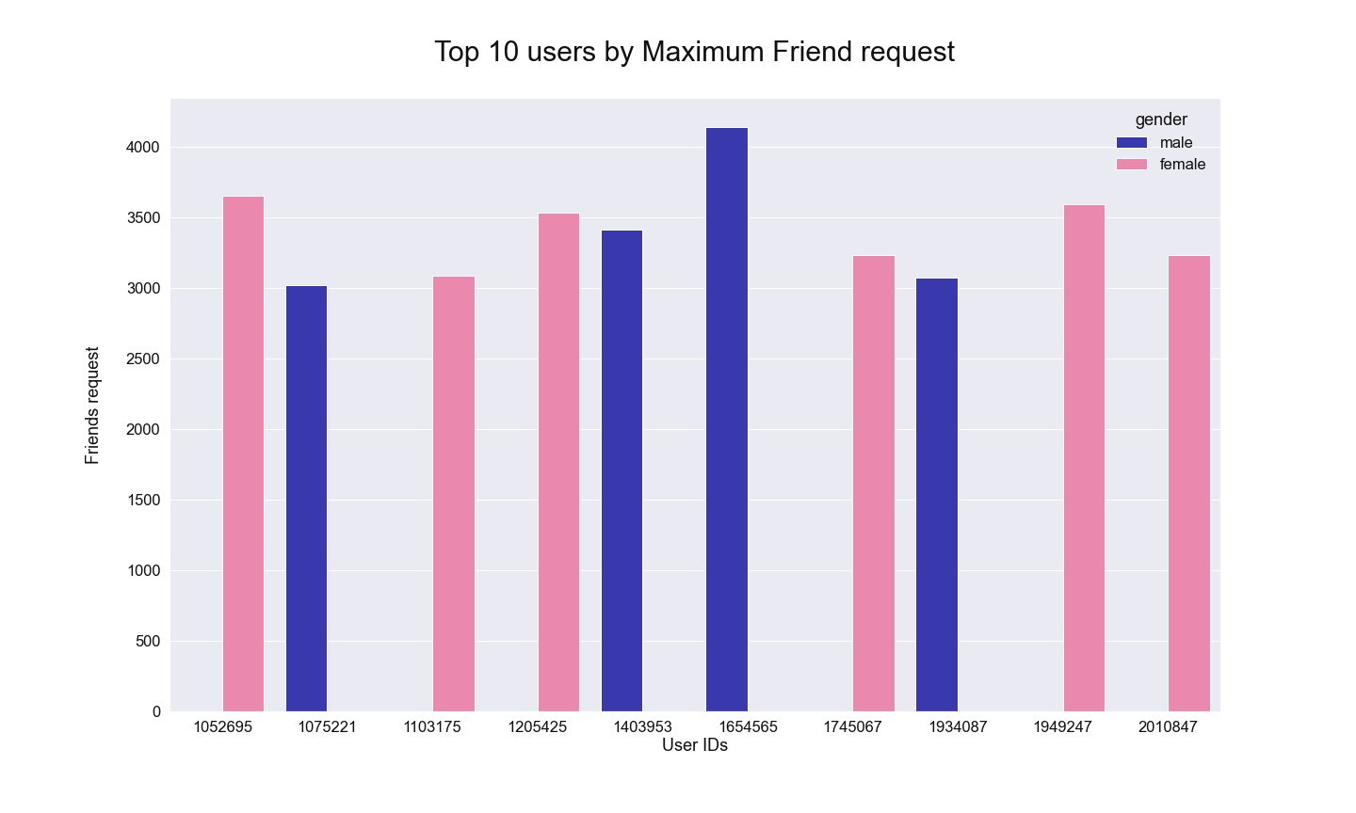
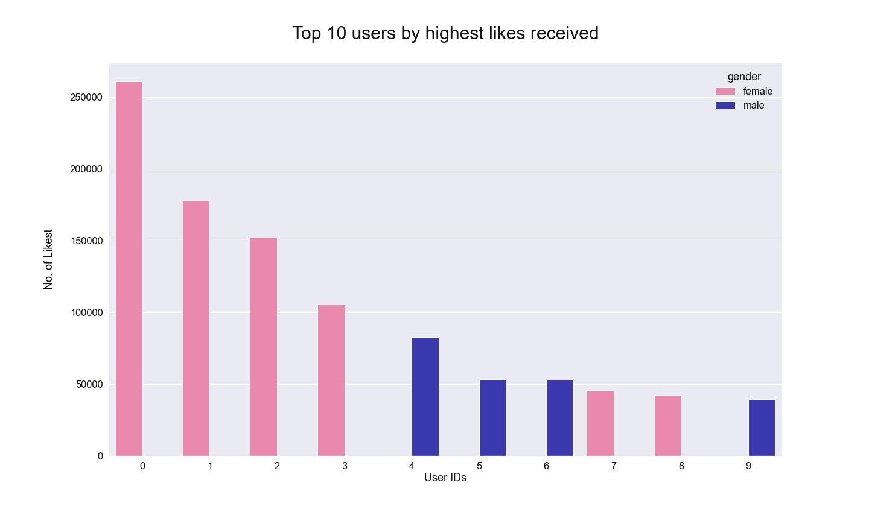
Next

Slide 12


6
4

Slide 13
6
4

Slide 14
6
4

Slide 15
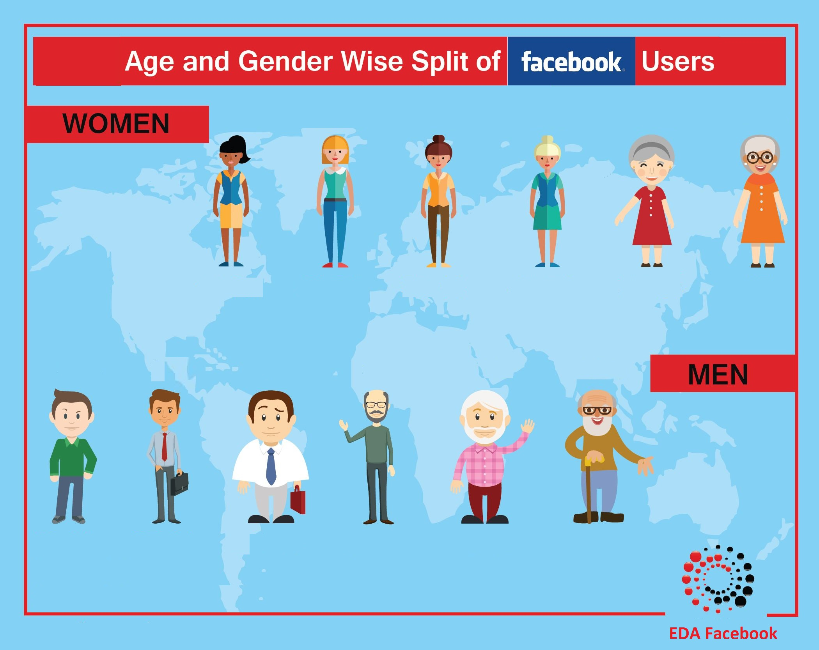

Slide 16
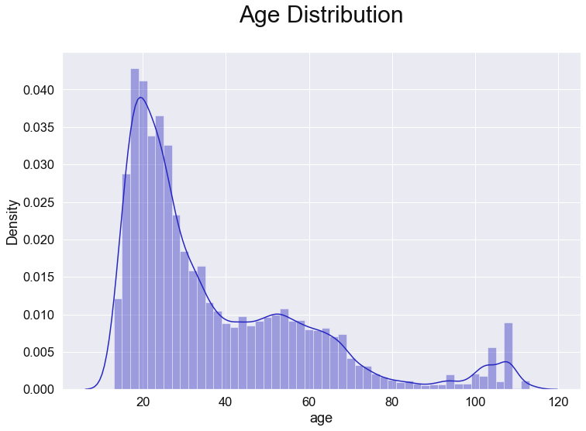
50%
Below Age 28

Slide 17
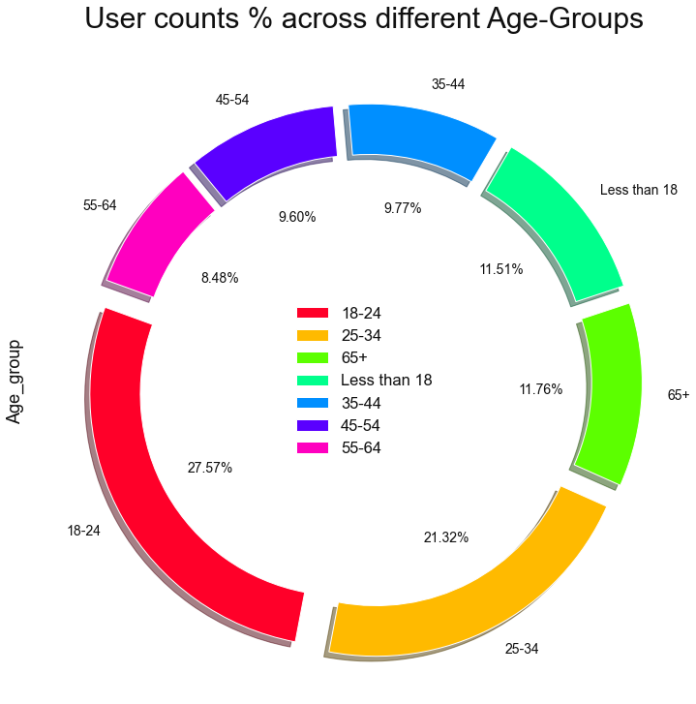
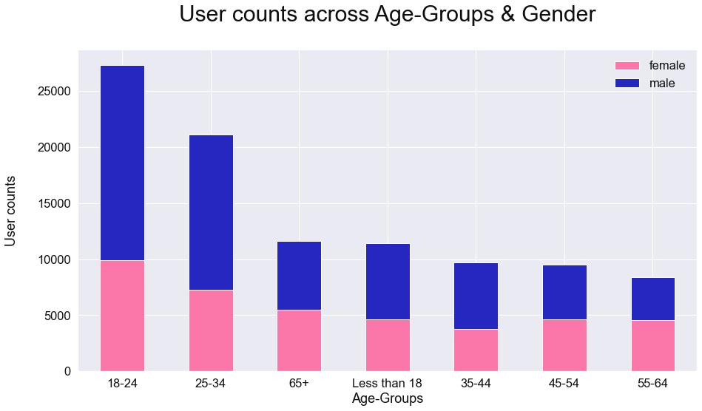
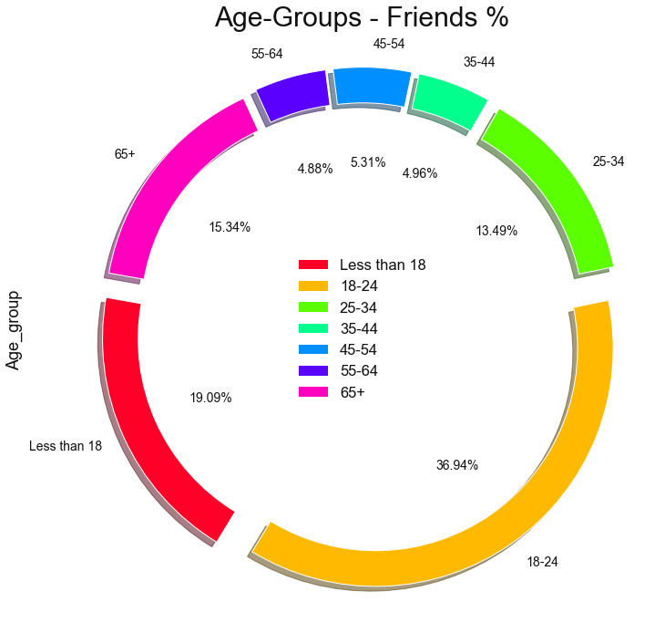
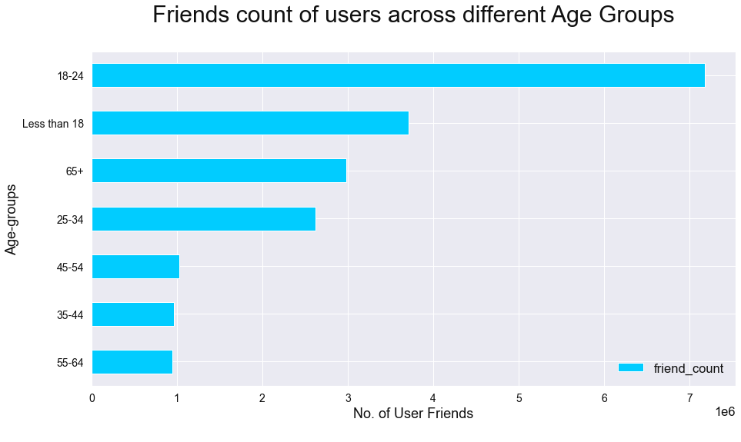
Next

Slide 18
60%
Less than 18
18-24
25-34
49%

Slide 19
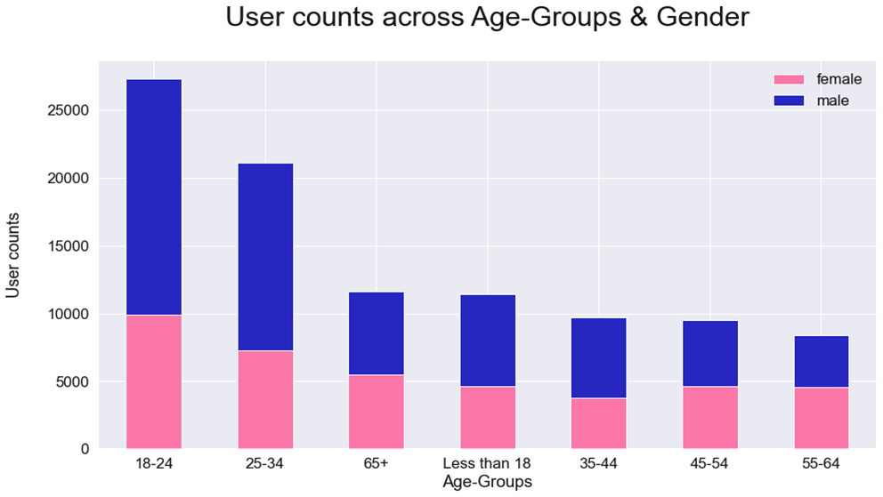
Except
55-64
Age group

Slide 20
56%
Less than 18
18-24

Slide 21
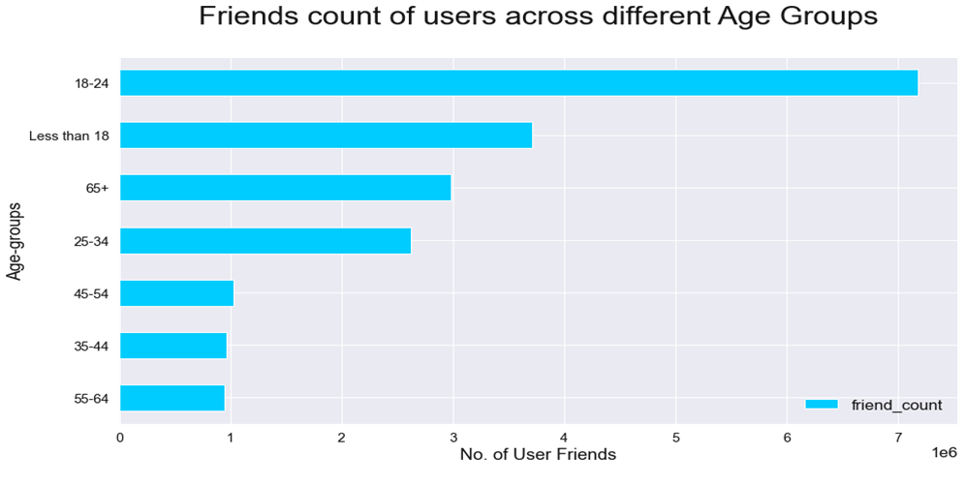
37%
19%

Slide 22
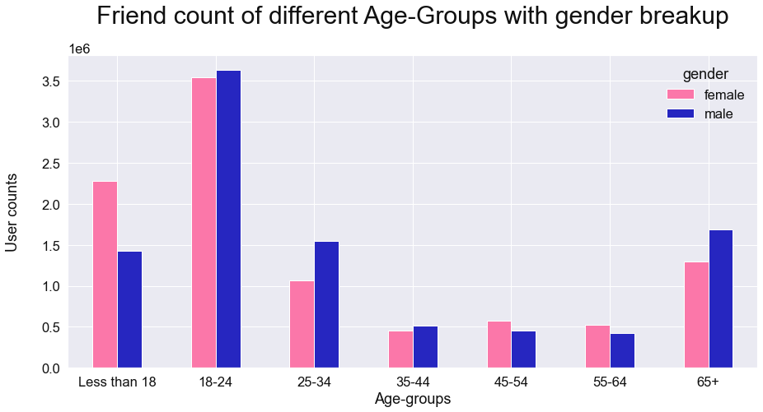
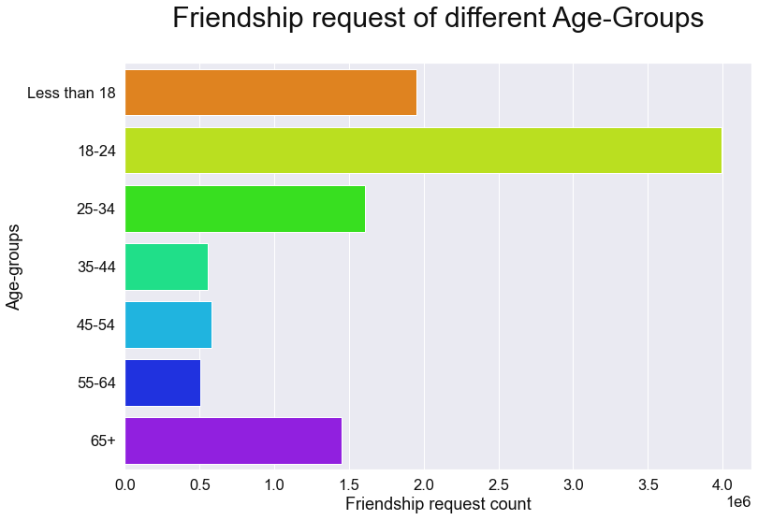
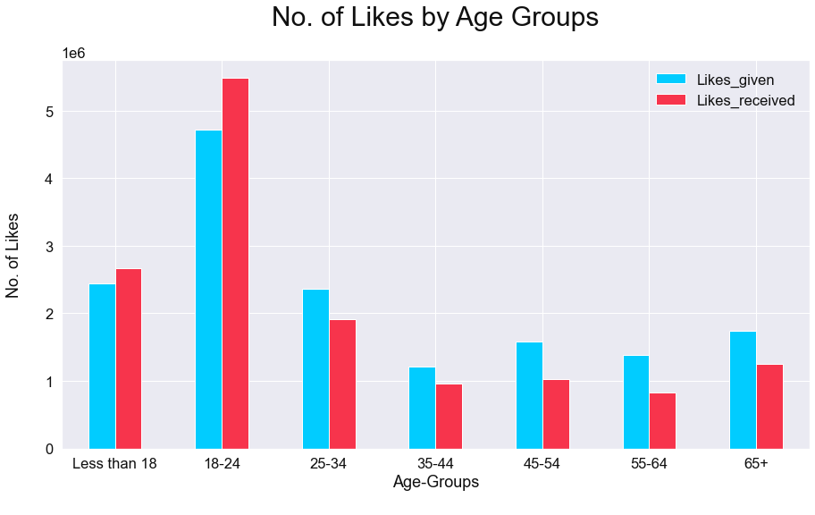
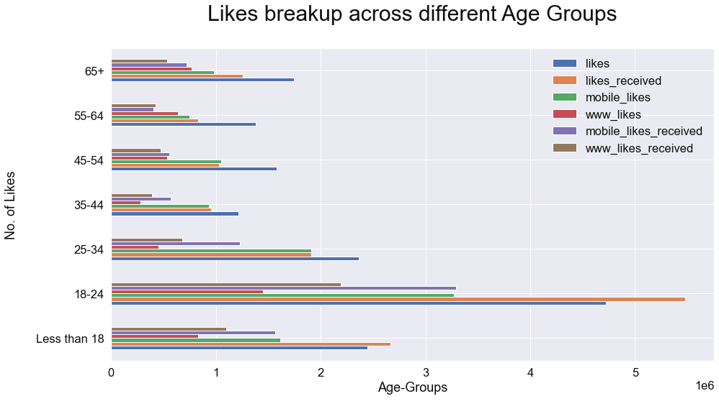
Next

Slide 23
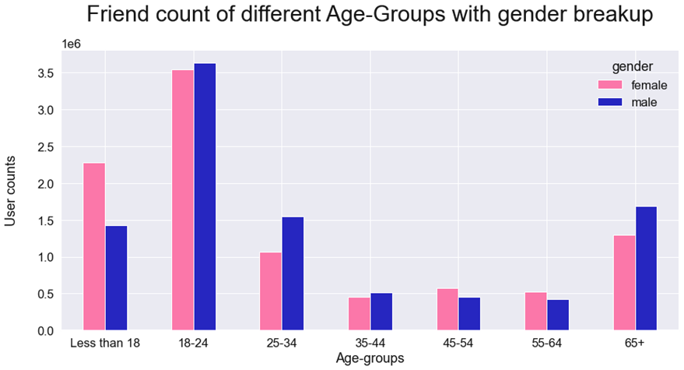

Slide 24
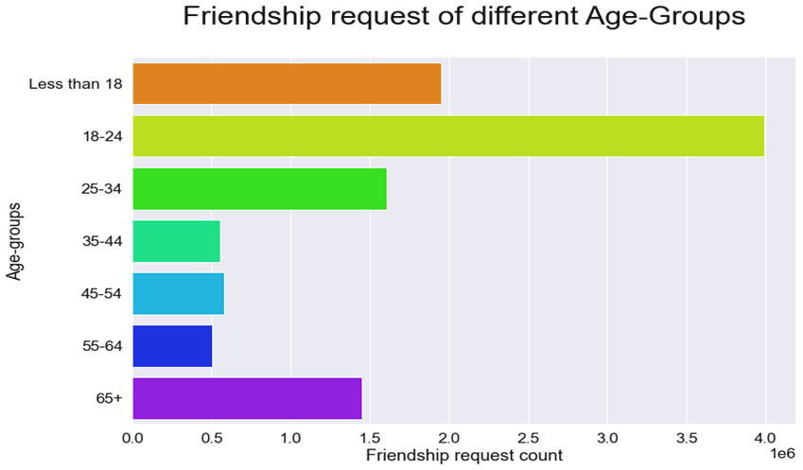

Slide 25
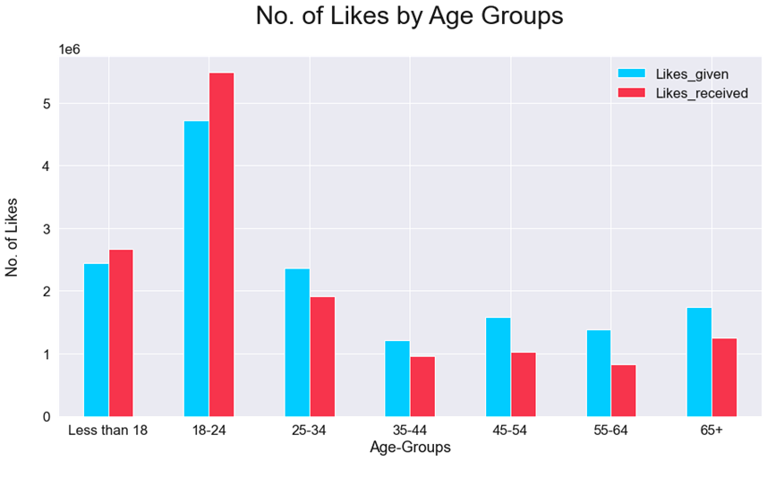

Slide 26
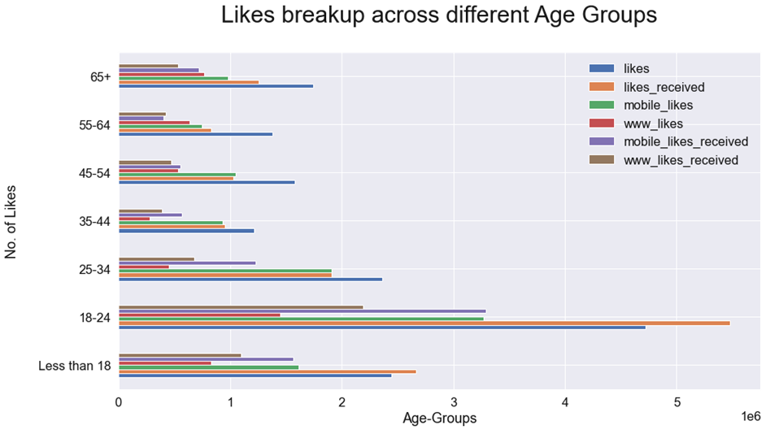

Slide 27


Slide 28
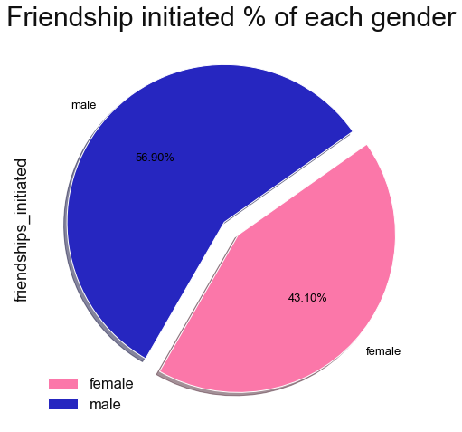
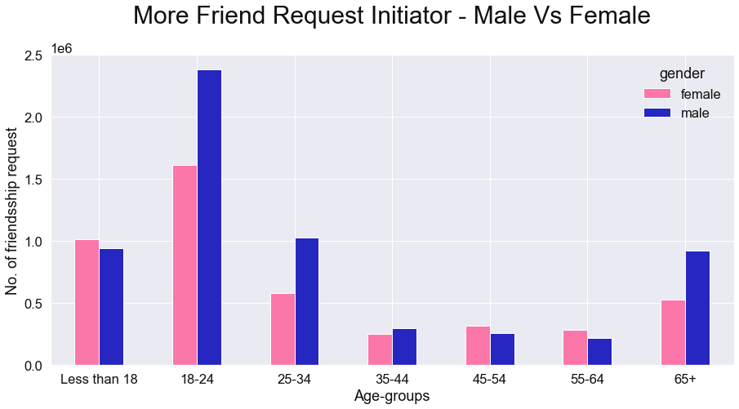
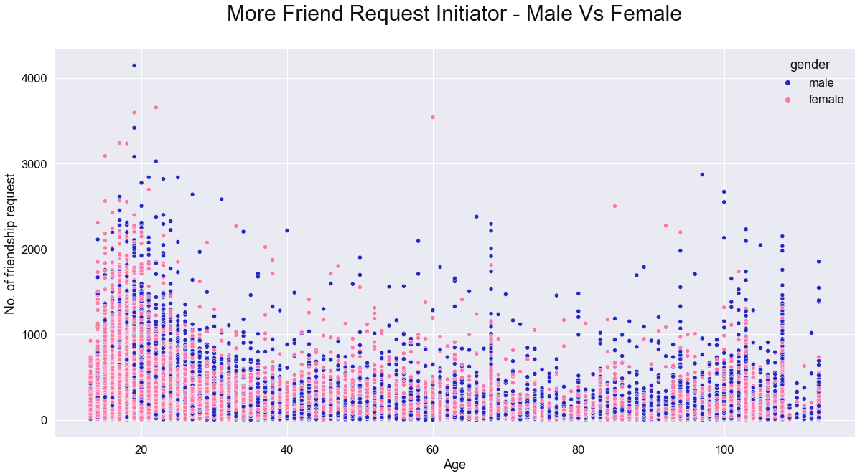

Slide 29
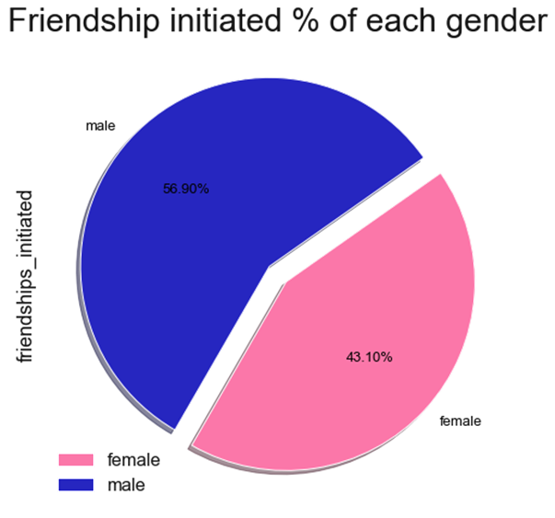

Slide 30
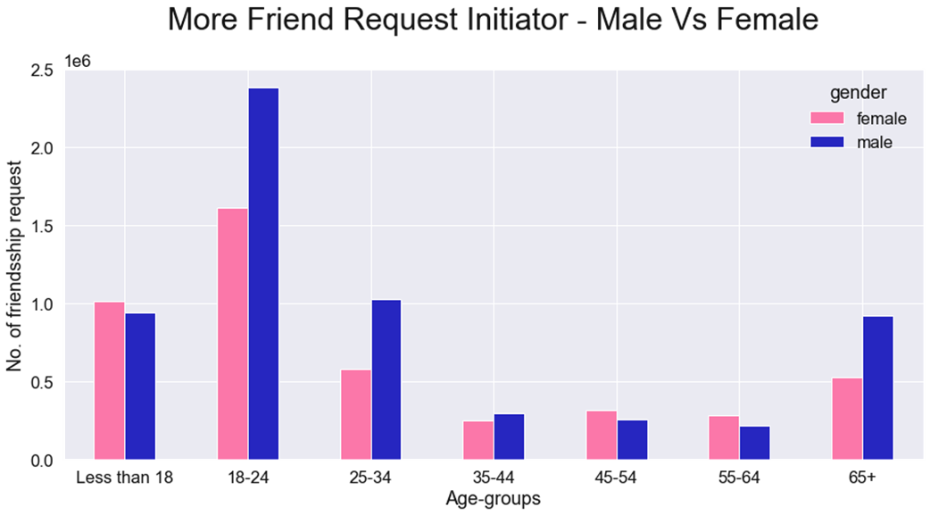

Slide 31
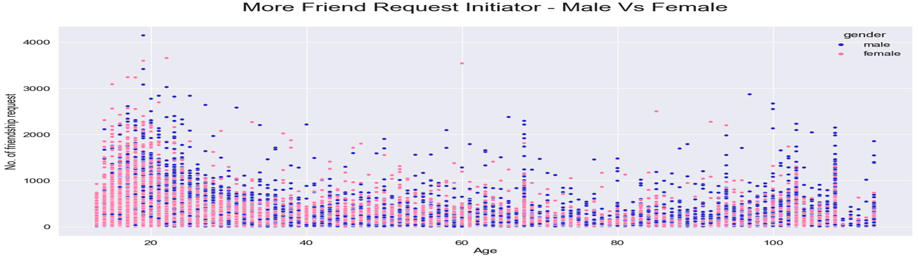

Slide 32
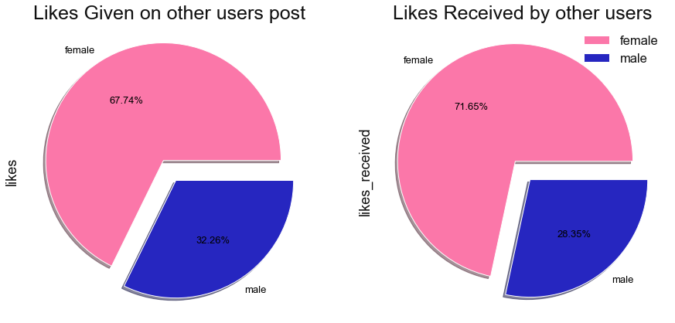

Slide 33
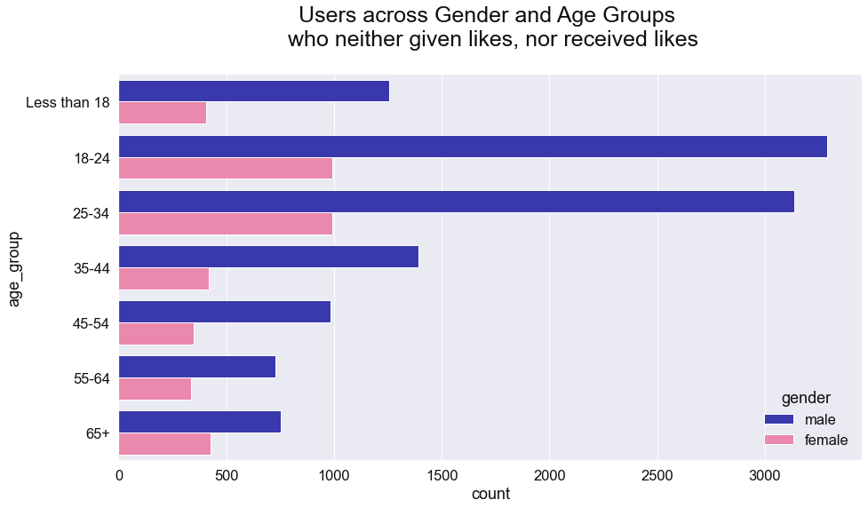
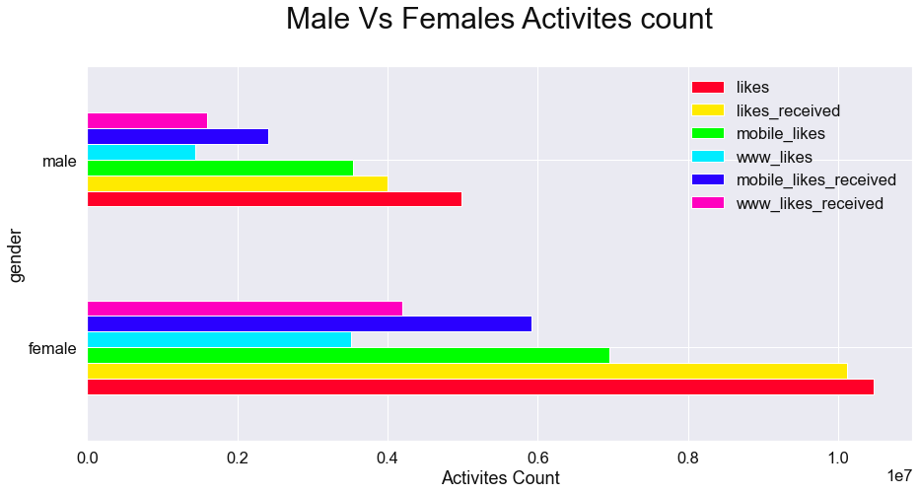
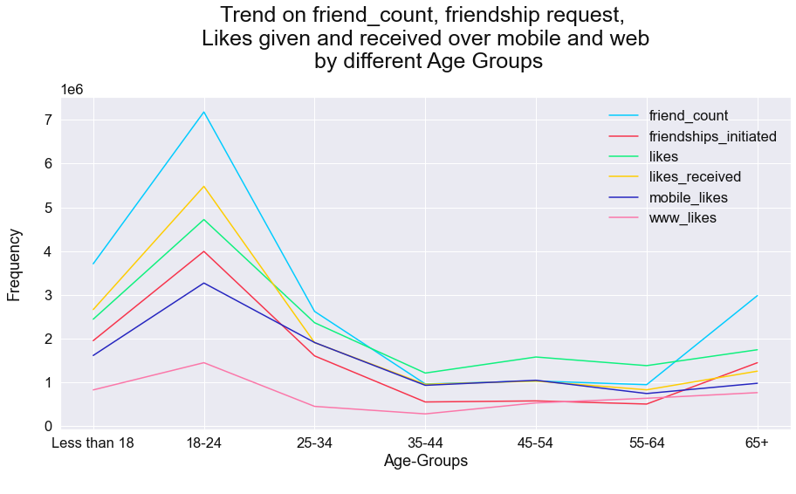
Next

Slide 34
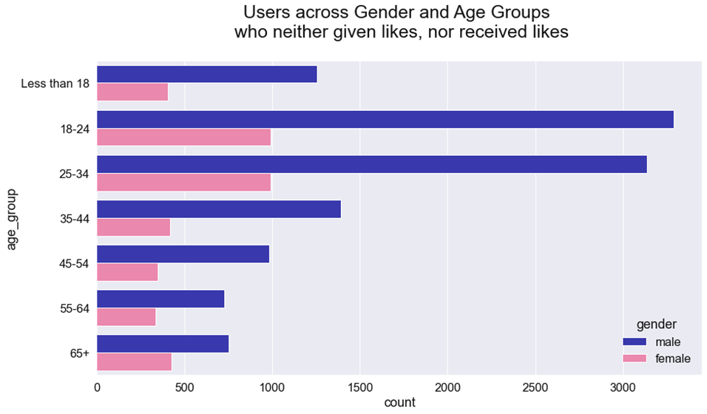
15.6%

Slide 35
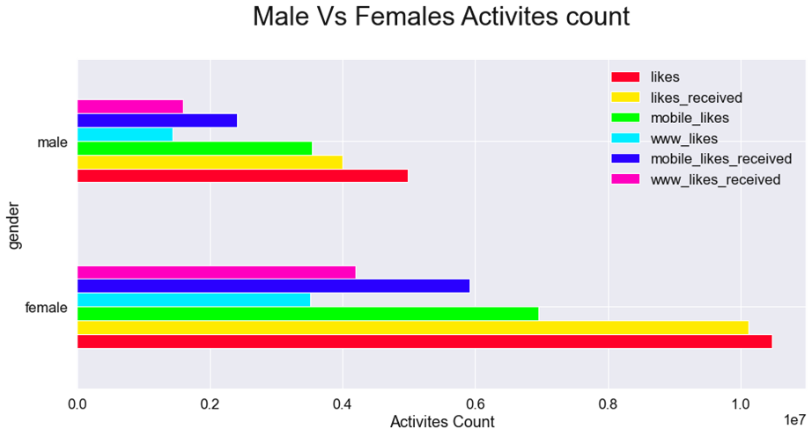

Slide 36
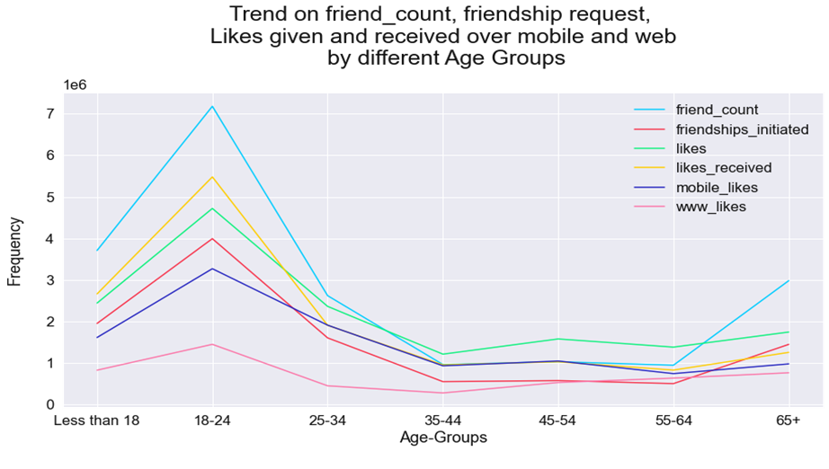

Slide 37


Slide 38
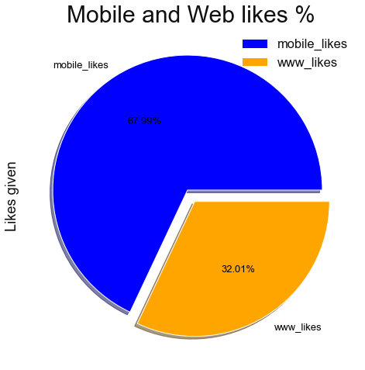

Slide 39
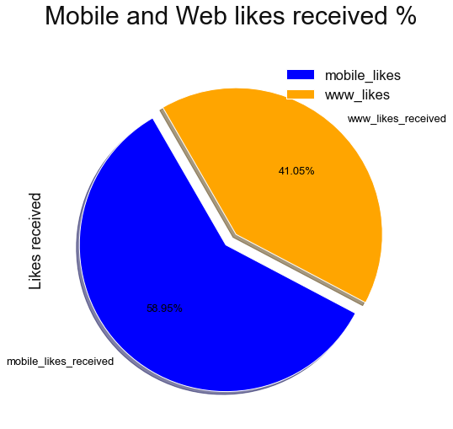

Slide 40
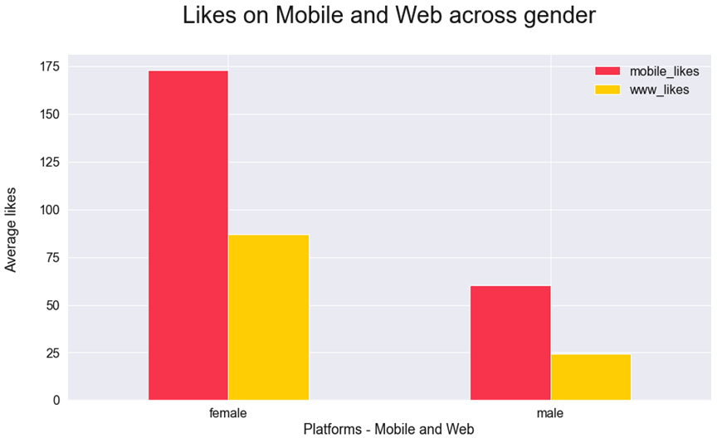

Slide 41
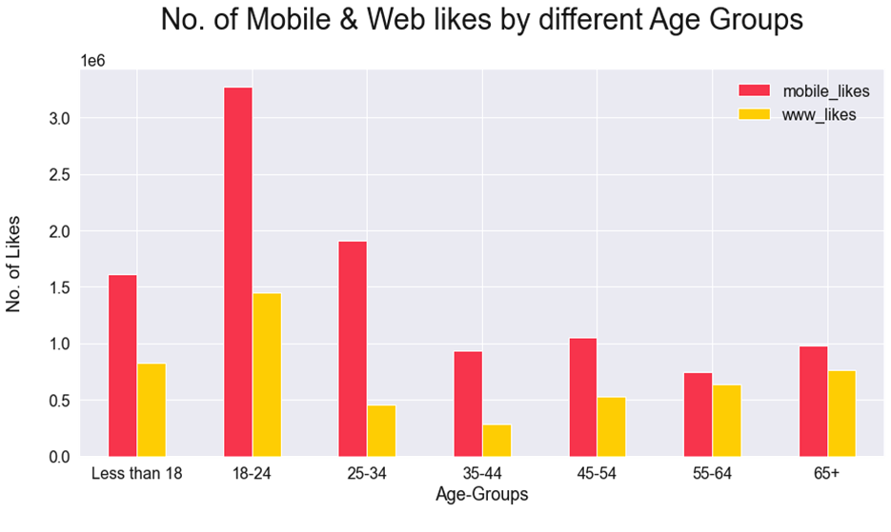

Slide 42
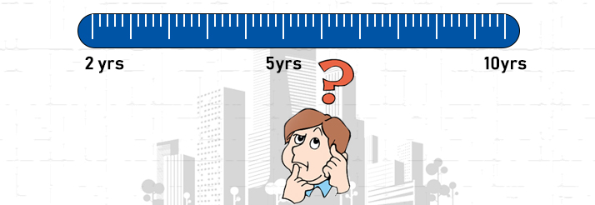

Slide 43
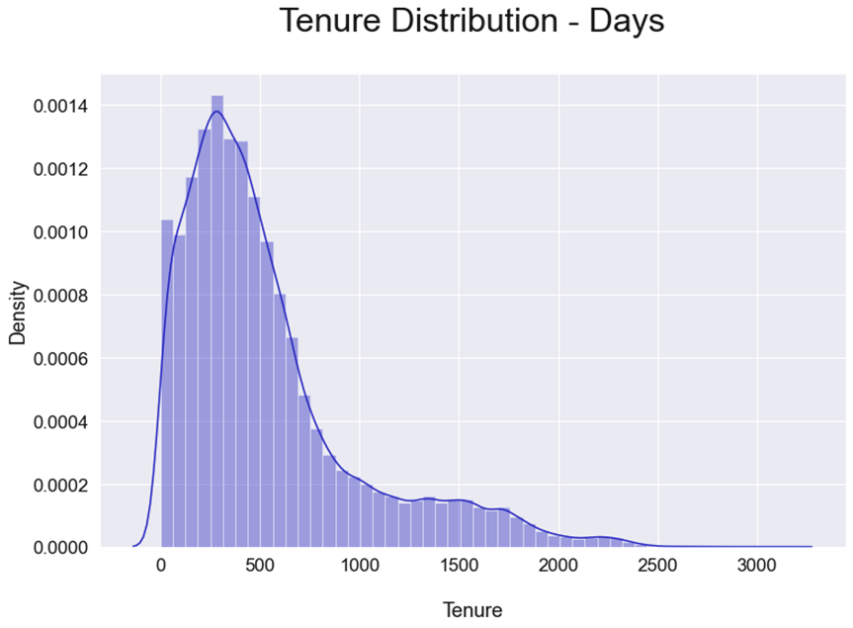

Slide 44
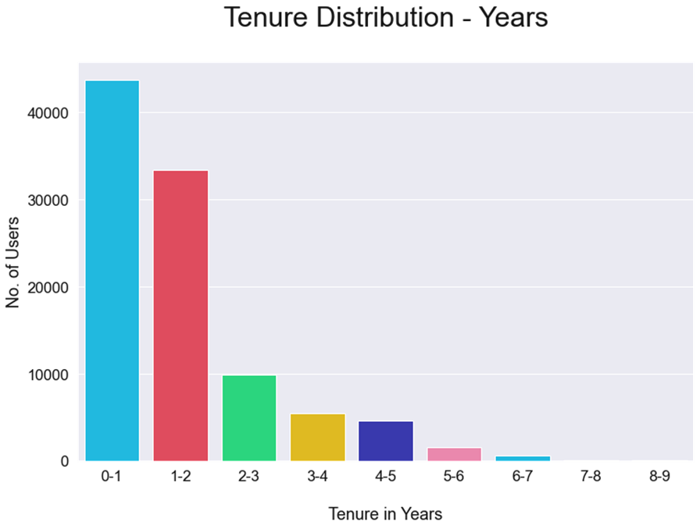

Slide 45
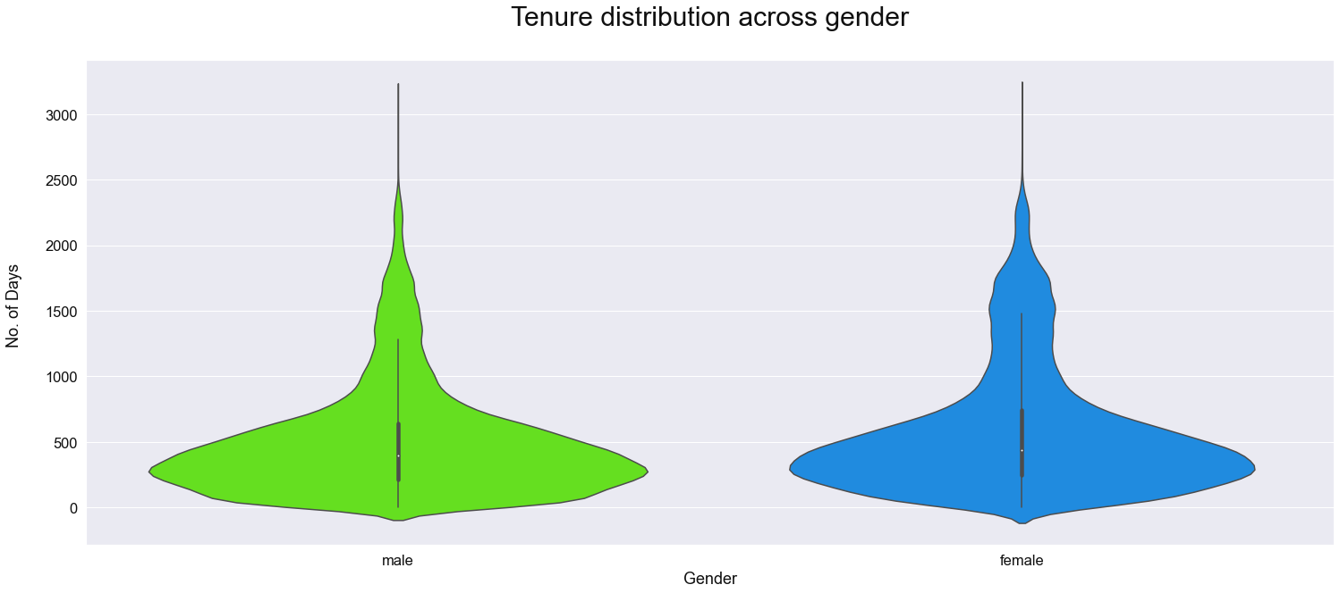

Slide 46
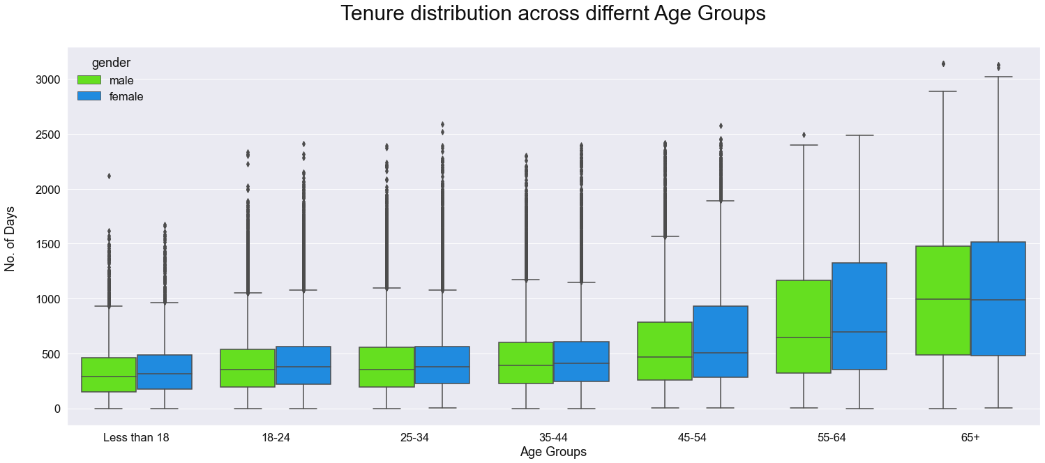

Slide 47


Conclusion
User
Demographic
Activity
Platform
Tenure
1
2
3
4
5
v
All age groups
13 - 113
Most Active Users: Female
Maximum users Tenure is less than 1 Year
Maximum users:
18-24 (27.5%), followed by 25-34 (21.3%) Age group
Mobile is the preferred choice of users
by both gender – Male and Female
Across all age group as compare to Web
M:F Ratio 60:40
Trend - Decline User Interest from Age 25 onwards and get flatten after age 35
Most of the new users joined in 1 year period
Female Average friend count is higher than male 60:40
Total users of these 2 groups: 49%
Average Tenure across majority of age groups is less than 2 Years.
Males 14% ahead in friendship request initiation
Most Active age group: 18-24
15.6% Passive user counts

Slide 48

Actionable Insight
Focus
On
Strategies and Programs
User Experience
v
Males
Enhance user experience by making existing features more simpler
Make Mobile platform more User friendly
Keep adding new features for masses
Age 25 onwards
15.6% Passive users
Leverage Top 10 facebook Users
Target Youth to increase user base and retention
Design more Programs and Services for
Females
Basis above insights, Facebook may focus on specific areas mentioned here, depending on their priorities.

Slide 49
Thank You!

